Slide 1

EEL4712 Digital Design
(Carry Lookahead Adder)

Slide 2
Introduction
There are many ways to implement a digital function, but each approach may have different tradeoffs
As a digital designer, you need to consider these tradeoffs when meeting design requirements
As an example, we’ll look into different adder architectures and their tradeoffs
Read Section 5.4 for more details

Slide 3
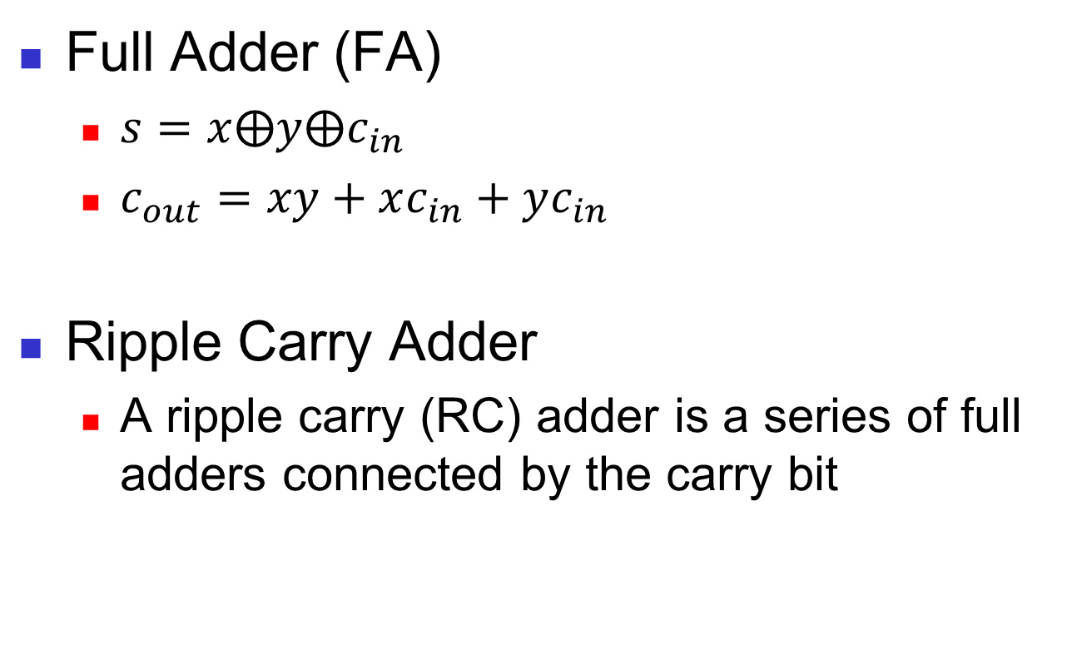
Ripple Carry Adder
Full Adder (FA)
$s=x⨁y⨁c_{in}$
$c_{out}=xy+xc_{in}+yc_{in}$
Ripple Carry Adder
A ripple carry (RC) adder is a series of full adders connected by the carry bit

Slide 4
Advantage: Area Impact
The ripple carry adder’s area grows linearly with bit width
Each additional bit adds another full adder and its associated gates
+5 gates
+5 gates
+5 gates
+5 gates

Slide 5
Disadvantage: Delay Impact
The ripple carry adder’s delay also grows linearly with bit width
Each full adder must wait for the previous full adder to produce outputs
Lower performance with bit width!
C₄@9Δ
C₃@7Δ
C₂@5Δ
C₁@3Δ

Slide 6
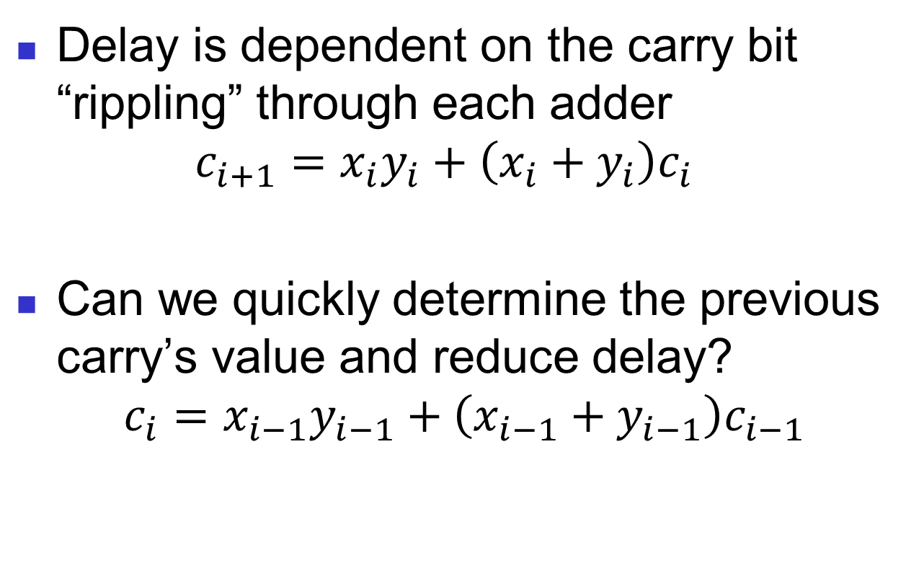
Delay Problem
Delay is dependent on the carry bit “rippling” through each adder $c_{i+1}=x_{i}y_{i}+\left(x_{i}+y_{i}\right)c_{i}$
Can we quickly determine the previous carry’s value and reduce delay?
$$c_{i}=x_{i−1}y_{i−1}+\left(x_{i−1}+y_{i−1}\right)c_{i−1}$$

Slide 7
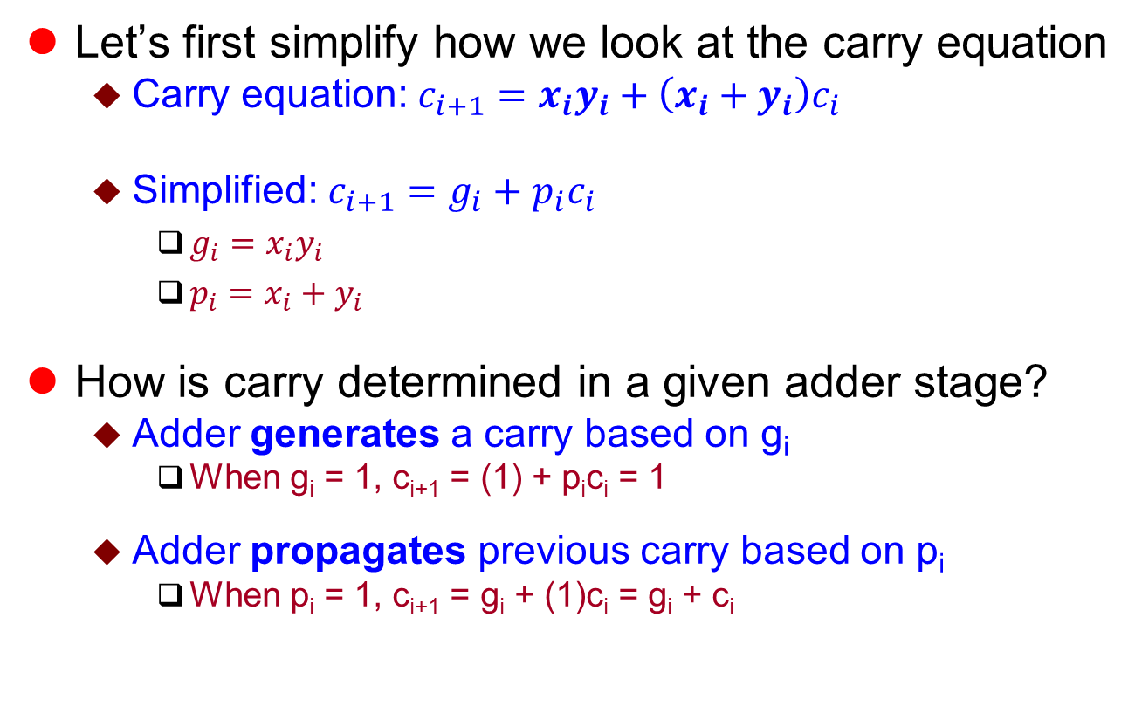
Simplifying Carry Equation
Let’s first simplify how we look at the carry equation
Carry equation: $c_{i+1}=x_{i}y_{i}+\left(x_{i}+y_{i}\right)c_{i}$
Simplified: $c_{i+1}=g_{i}+p_{i}c_{i}$
$g_{i}=x_{i}y_{i}$
$p_{i}=x_{i}+y_{i}$
How is carry determined in a given adder stage?
Adder generates a carry based on g_{i}
When g_{i} = 1, c_{i+1} = (1) + p_{i}c_{i} = 1
Adder propagates previous carry based on p_{i}
When p_{i} = 1, c_{i+1} = g_{i} + (1)c_{i} = g_{i} + c_{i}

Slide 8
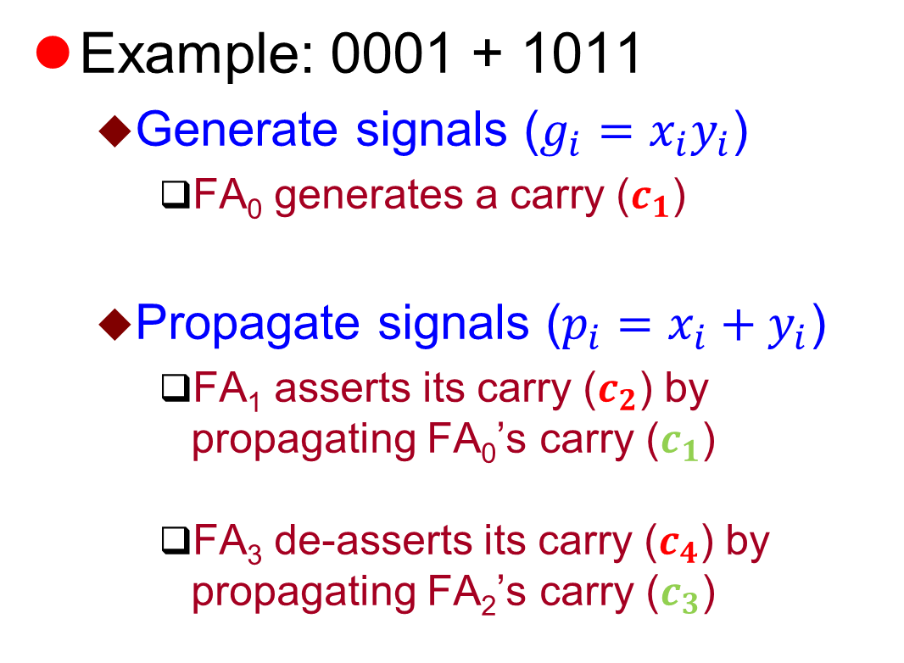
Generate/Propagate Example
Example: 0001 + 1011
Generate signals ($g_{i}=x_{i}y_{i}$)
FA₀ generates a carry ($c_{1}$)
Propagate signals ($p_{i}=x_{i}+y_{i}$)
FA₁ asserts its carry ($c_{2}$) by propagating FA₀’s carry ($c_{1}$)
FA₃ de-asserts its carry ($c_{4}$) by propagating FA₂’s carry ($c_{3}$)
1
0001
+1011
0
11
0001
+1011
00
0011
0001
+1011
1100

Slide 9
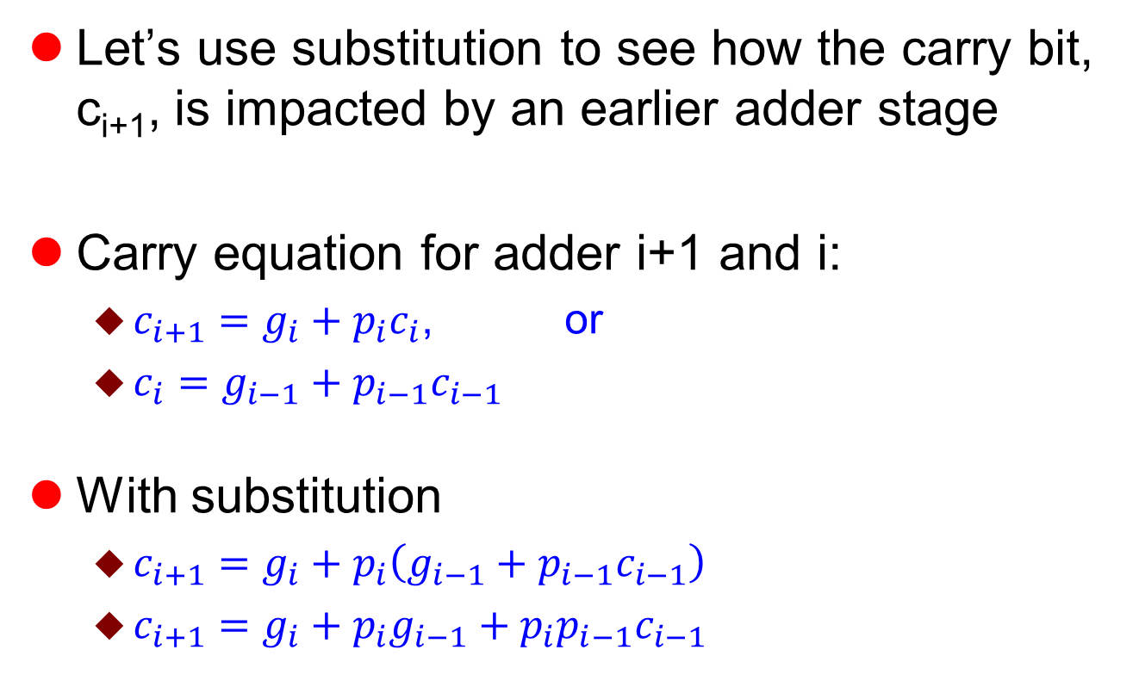
Carry Substitution
Let’s use substitution to see how the carry bit, c_{i+1}, is impacted by an earlier adder stage
Carry equation for adder i+1 and i:
$c_{i+1}=g_{i}+p_{i}c_{i}$, or
$c_{i}=g_{i−1}+p_{i−1}c_{i−1}$
With substitution
$c_{i+1}=g_{i}+p_{i}\left(g_{i−1}+p_{i−1}c_{i−1}\right)$
$c_{i+1}=g_{i}+{p_{i}g}_{i−1}+p_{i}p_{i−1}c_{i−1}$
c_{i}

Slide 10
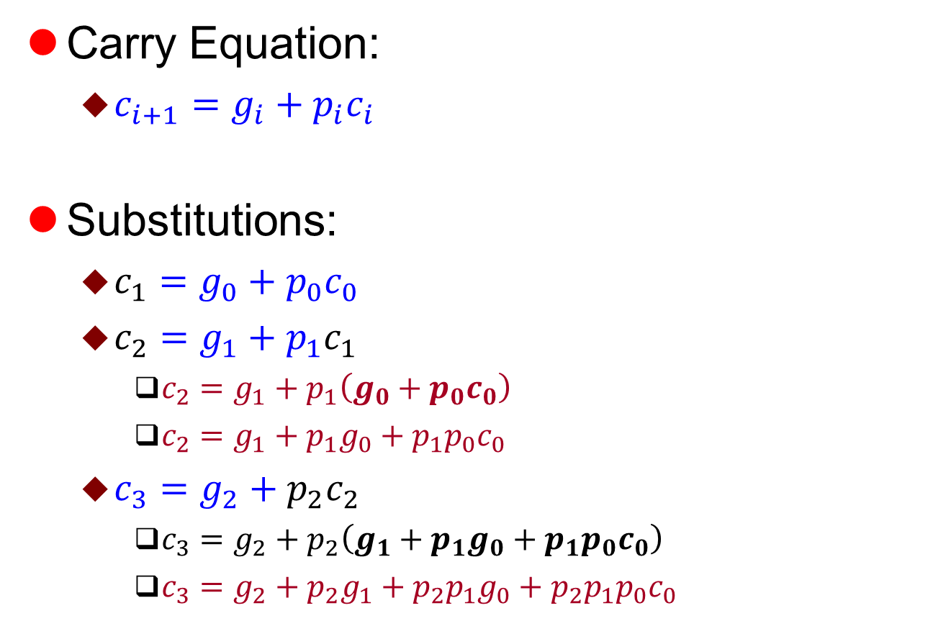
Carry Pattern
Carry Equation:
$c_{i+1}=g_{i}+p_{i}c_{i}$
Substitutions:
$c_{1}=g_{0}+p_{0}c_{0}$
$c_{2}=g_{1}+p_{1}c_{1}$
$c_{2}=g_{1}+p_{1}\left(g_{0}+p_{0}c_{0}\right)$
$c_{2}=g_{1}+p_{1}g_{0}+p_{1}p_{0}c_{0}$
$c_{3}=g_{2}+p_{2}c_{2}$
$c_{3}=g_{2}+p_{2}\left(g_{1}+p_{1}g_{0}+p_{1}p_{0}c_{0}\right)$
$c_{3}=g_{2}+p_{2}g_{1}+p_{2}p_{1}g_{0}+p_{2}p_{1}p_{0}c_{0}$
c₁
c₂

Slide 11
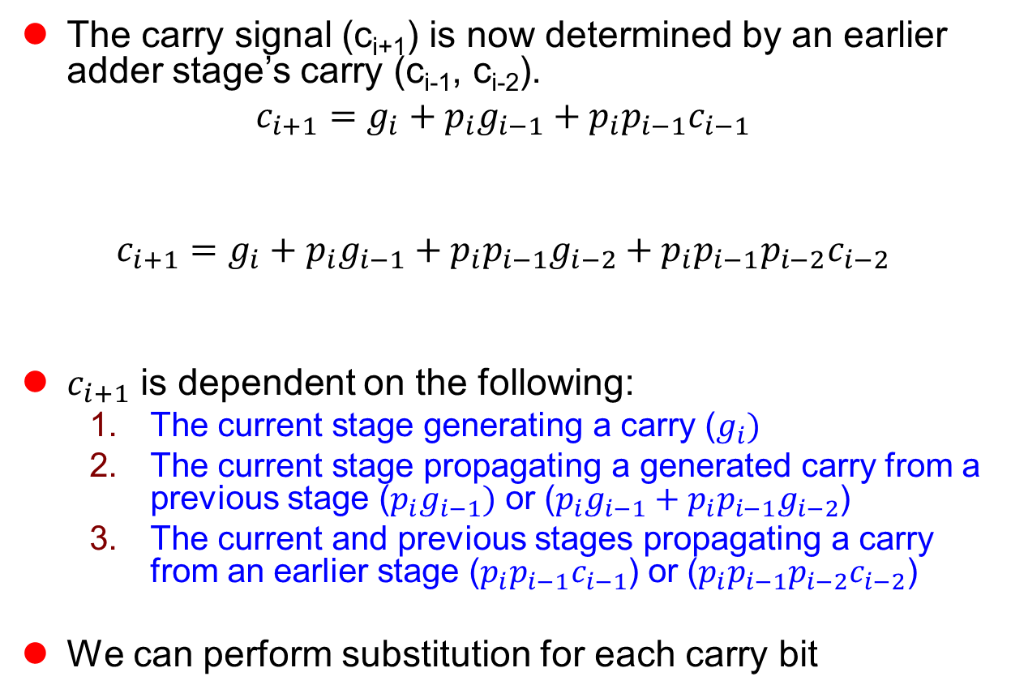
Removing Dependencies
The carry signal (c_{i+1}) is now determined by an earlier adder stage’s carry (c_{i-1}, c_{i-2}).
$$c_{i+1}=g_{i}+{p_{i}g}_{i−1}+p_{i}p_{i−1}c_{i−1}$$
$$c_{i+1}=g_{i}+{p_{i}g}_{i−1}+p_{i}p_{i−1}g_{i−2}+p_{i}p_{i−1}p_{i−2}c_{i−2}$$
$c_{i+1}$ is dependent on the following:
The current stage generating a carry ($g_{i})$
The current stage propagating a generated carry from a previous stage ($p_{i}g_{i−1})$ or (${p_{i}g}_{i−1}+p_{i}p_{i−1}g_{i−2}$)
The current and previous stages propagating a carry from an earlier stage ($p_{i}p_{i−1}c_{i−1}$) or ($p_{i}p_{i−1}p_{i−2}c_{i−2}$)
We can perform substitution for each carry bit
Case 1
Case 2
Case 3
Case 1
Case 2
Case 3

Slide 12
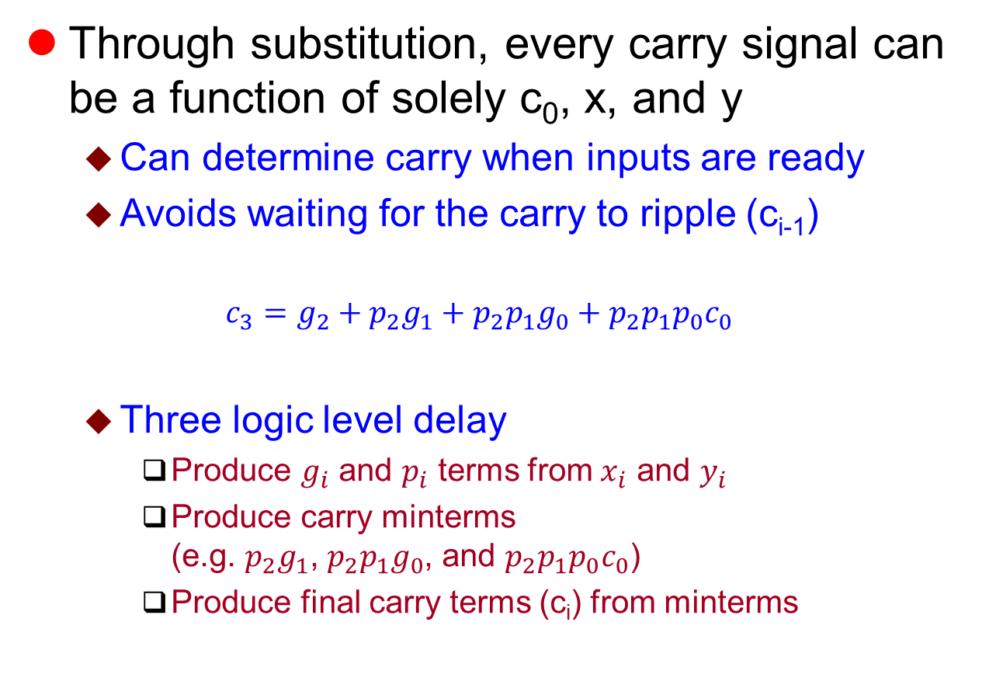
New Carry Dependence
Through substitution, every carry signal can be a function of solely c₀, x, and y
Can determine carry when inputs are ready
Avoids waiting for the carry to ripple (c_{i-1})
$$c_{3}=g_{2}+p_{2}g_{1}+p_{2}p_{1}g_{0}+p_{2}p_{1}p_{0}c_{0}$$
Three logic level delay
Produce $g_{i}$ and $p_{i}$ terms from $x_{i}$ and $y_{i}$
Produce carry minterms (e.g. $p_{2}g_{1}$, $p_{2}p_{1}g_{0}$, and $p_{2}p_{1}p_{0}c_{0}$)
Produce final carry terms (c_{i}) from minterms

Slide 13
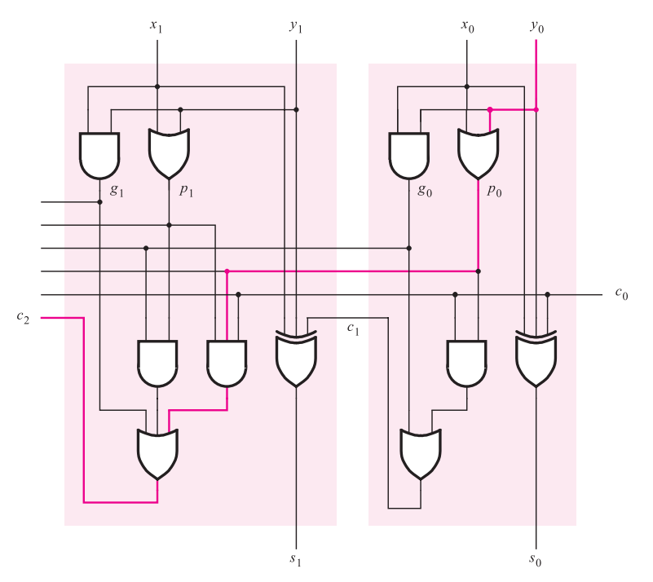
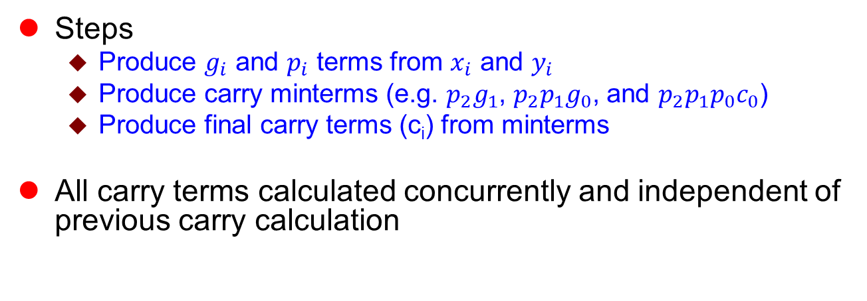
Carry Lookahead Adder (CLA)
Steps
Produce $g_{i}$ and $p_{i}$ terms from $x_{i}$ and $y_{i}$
Produce carry minterms (e.g. $p_{2}g_{1}$, $p_{2}p_{1}g_{0}$, and $p_{2}p_{1}p_{0}c_{0}$)
Produce final carry terms (c_{i}) from minterms
All carry terms calculated concurrently and independent of previous carry calculation
propagate/generate terms
carry minterms
carry term
[1]

Slide 14
Constant Delay
The propagation delay is now constant, even as the adder width increases!
Each of the CLA adder stages calculate its outputs concurrently
By contrast, RC ripples carry through each stage and has a variable delay based on width

Slide 15
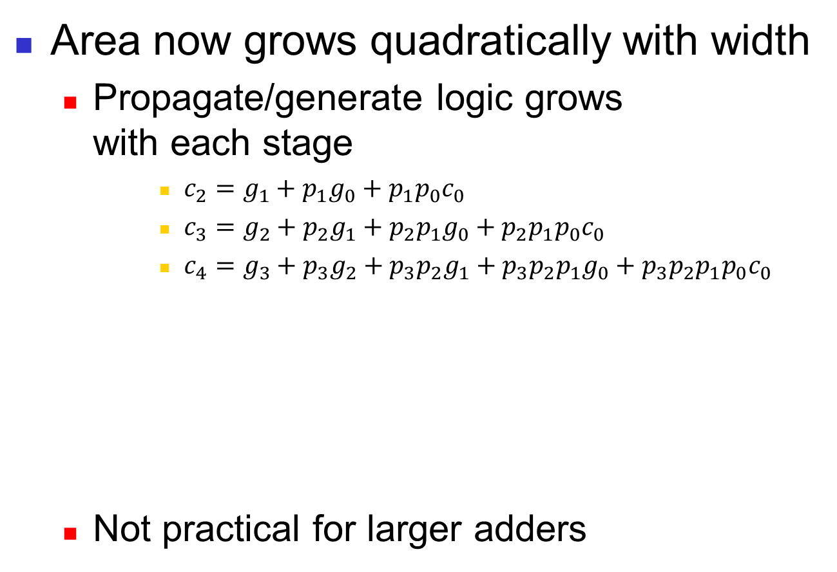
Area Cost
Area now grows quadratically with width
Propagate/generate logic grows with each stage
$c_{2}=g_{1}+p_{1}g_{0}+p_{1}p_{0}c_{0}$
$c_{3}=g_{2}+p_{2}g_{1}+p_{2}p_{1}g_{0}+p_{2}p_{1}p_{0}c_{0}$
$c_{4}=g_{3}+p_{3}g_{2}+p_{3}p_{2}g_{1}+p_{3}p_{2}p_{1}g_{0}+p_{3}p_{2}p_{1}p_{0}c_{0}$
Not practical for larger adders

Slide 16
Other Tradeoffs?
We know of two adders with different advantages as width increases
The ripple carry’s area grows linearly, but suffers from linear growth in delay
The carry lookahead’s delay is constant, but suffers from quadratic growth in area
Use hybrid architecture to limit both area and delay growth?

Slide 17
Hybrid Approach
Make a ripple carry architecture out of multi-bit CLAs adders, or CLA blocks
E.g. 4-bit CLA adders connected in a ripple carry fashion

Slide 18
Area Impact
The hybrid adder’s area grows linearly
Additional bits add another CLA adder and its associated gates
Slower area growth than pure CLA, but larger area than pure RC

Slide 19
Delay Impact
The hybrid adder’s delay grows linearly
Each CLA adder must wait for the previous CLA adder to produce outputs
But no longer on a bit-by-bit basis!
Lower delay growth than pure RC

Slide 20
Alternative Hierarchical Approach
In the hybrid approach, we use the RC architecture on multi-bit CLA adders
Alternatively, we can also use the CLA architecture with multi-bit CLA adders
Use CLA architecture to gain constant delay as width increases
Must determine propagate and generate logic on a CLA block-basis

Slide 21
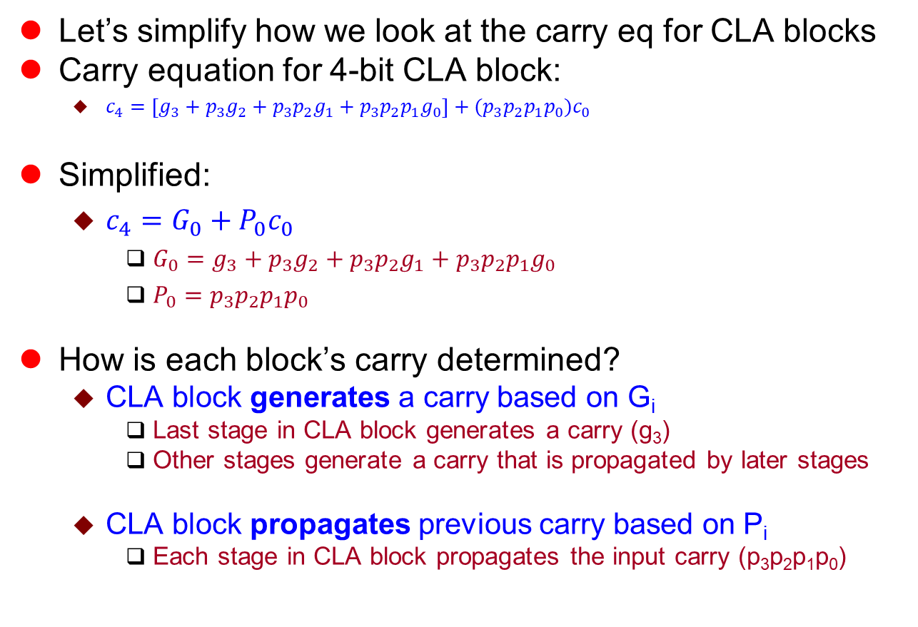
Another Look at Carry Equations
Let’s simplify how we look at the carry eq for CLA blocks
Carry equation for 4-bit CLA block:
$c_{4}=\left[g_{3}+p_{3}g_{2}+p_{3}p_{2}g_{1}+p_{3}p_{2}p_{1}g_{0}\right]+(p_{3}p_{2}p_{1}p_{0})c_{0}$
Simplified:
$c_{4}=G_{0}+P_{0}c_{0}$
$G_{0}=g_{3}+p_{3}g_{2}+p_{3}p_{2}g_{1}+p_{3}p_{2}p_{1}g_{0}$
$P_{0}=p_{3}p_{2}p_{1}p_{0}$
How is each block’s carry determined?
CLA block generates a carry based on G_{i}
Last stage in CLA block generates a carry (g₃)
Other stages generate a carry that is propagated by later stages
CLA block propagates previous carry based on P_{i}
Each stage in CLA block propagates the input carry (p₃p₂p₁p₀)

Slide 22
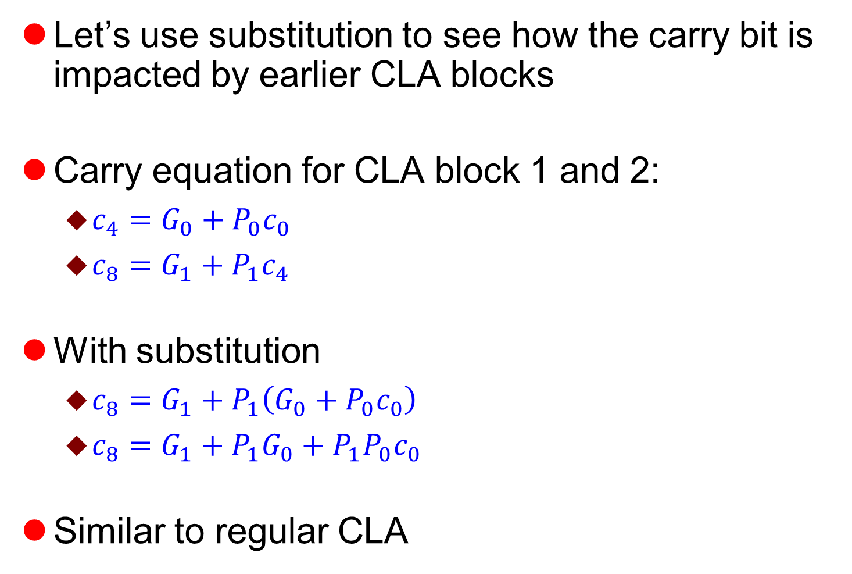
Hierarchical Carry Substitution
Let’s use substitution to see how the carry bit is impacted by earlier CLA blocks
Carry equation for CLA block 1 and 2:
$c_{4}=G_{0}+P_{0}c_{0}$
$c_{8}=G_{1}+P_{1}c_{4}$
With substitution
$c_{8}=G_{1}+P_{1}\left(G_{0}+P_{0}c_{0}\right)$
$c_{8}=G_{1}+P_{1}G_{0}+P_{1}P_{0}c_{0}$
Similar to regular CLA

Slide 23
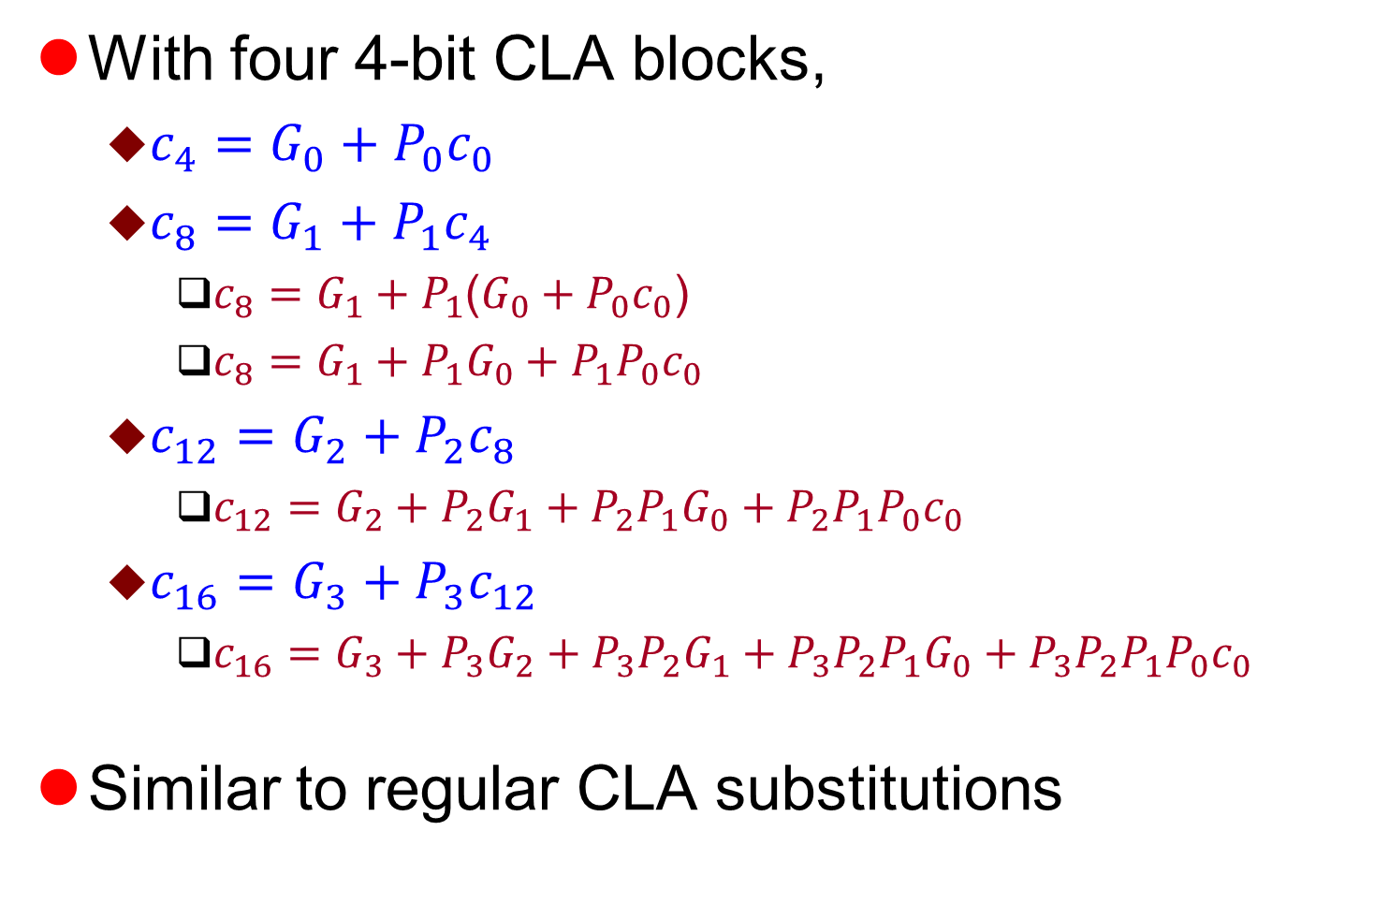
Hierarchical Substitutions
With four 4-bit CLA blocks,
$c_{4}=G_{0}+P_{0}c_{0}$
$c_{8}=G_{1}+P_{1}c_{4}$
$c_{8}=G_{1}+P_{1}$($G_{0}+P_{0}c_{0}$)
$c_{8}=G_{1}+P_{1}G_{0}+P_{1}P_{0}c_{0}$
$c_{12}=G_{2}+P_{2}c_{8}$
$c_{12}=G_{2}+P_{2}G_{1}+P_{2}P_{1}G_{0}+P_{2}P_{1}P_{0}c_{0}$
$c_{16}=G_{3}+P_{3}c_{12}$
$c_{16}=G_{3}+P_{3}G_{2}+P_{3}P_{2}G_{1}+P_{3}P_{2}P_{1}G_{0}+P_{3}P_{2}P_{1}P_{0}c_{0}$
Similar to regular CLA substitutions

Slide 24
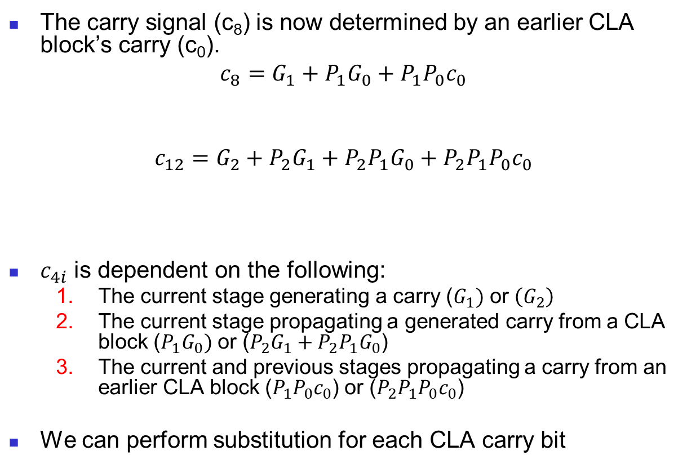
Removing Dependencies
The carry signal (c₈) is now determined by an earlier CLA block’s carry (c₀).
$$c_{8}=G_{1}+P_{1}G_{0}+P_{1}P_{0}c_{0}$$
$$c_{12}=G_{2}+P_{2}G_{1}+P_{2}P_{1}G_{0}+P_{2}P_{1}P_{0}c_{0}$$
$c_{4i}$ is dependent on the following:
The current stage generating a carry ($G_{1})$ or $\left(G_{2}\right)$
The current stage propagating a generated carry from a CLA block ($P_{1}G_{0})$ or ($P_{2}G_{1}+P_{2}P_{1}G_{0}$)
The current and previous stages propagating a carry from an earlier CLA block ($P_{1}P_{0}c_{0}$) or ($P_{2}P_{1}P_{0}c_{0}$)
We can perform substitution for each CLA carry bit
Case 1
Case 2
Case 3
Case 1
Case 2
Case 3

Slide 25
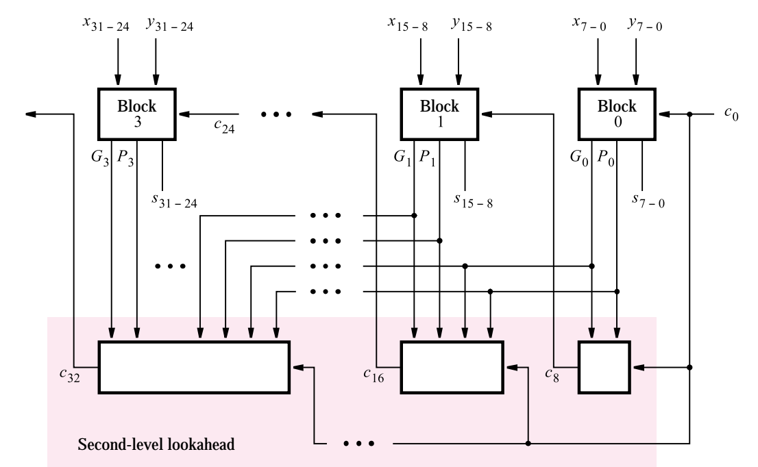
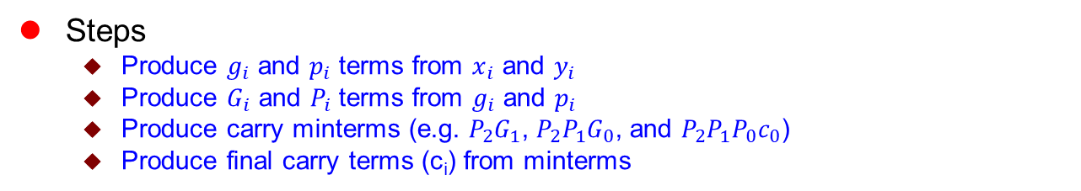
Hierarchical CLA
Steps
Produce $g_{i}$ and $p_{i}$ terms from $x_{i}$ and $y_{i}$
Produce $G_{i}$ and $P_{i}$ terms from $g_{i}$ and $p_{i}$
Produce carry minterms (e.g. $P_{2}G_{1}$, $P_{2}P_{1}G_{0}$, and $P_{2}P_{1}P_{0}c_{0}$)
Produce final carry terms (c_{i}) from minterms
propagate/generate terms (steps 1 & 2)
carry terms (steps 3 & 4)
Figure 2. A hierarchical carry-lookahead adder [1]

Slide 26
Hierarchical CLA
Compared to pure CLA
Smaller quadratic area growth
Block propagate/generate logic extracts common propagate/generate terms
Avoids duplicating gates for common propagate/generate terms in each carry equation
Larger constant delay due to block propagate/generate logic.
Figure 2. A hierarchical carry-lookahead adder [1]

Slide 27
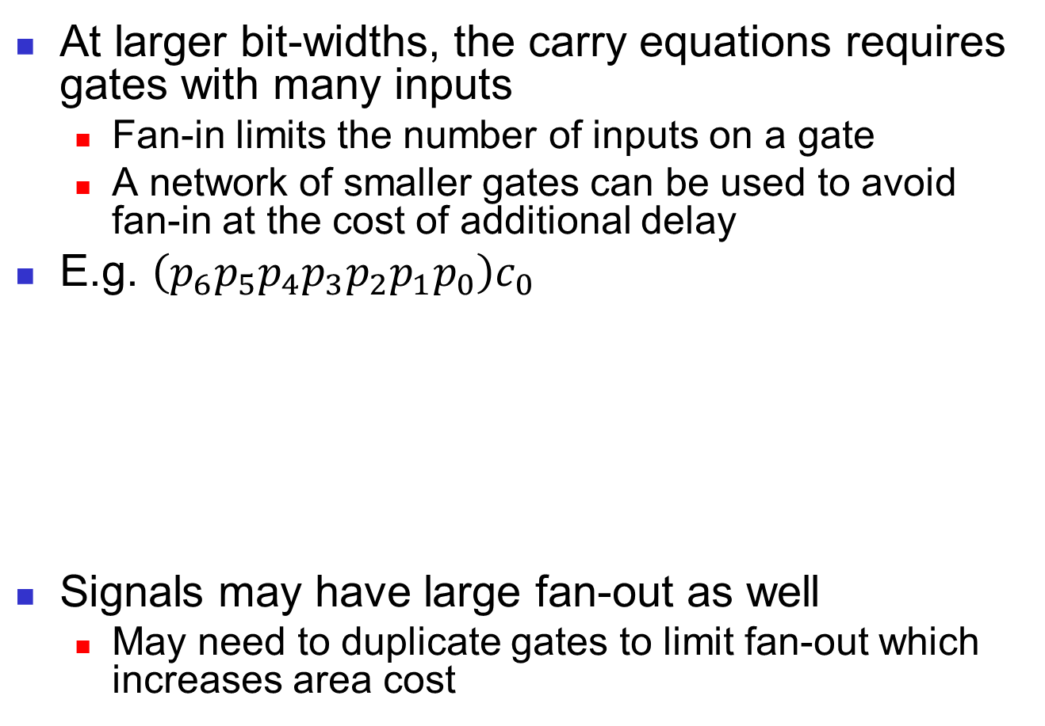
Practical Limitations
At larger bit-widths, the carry equations requires gates with many inputs
Fan-in limits the number of inputs on a gate
A network of smaller gates can be used to avoid fan-in at the cost of additional delay
E.g. $\left(p_{6}p_{5}p_{4}p_{3}p_{2}p_{1}p_{0}\right)c_{0}$
Signals may have large fan-out as well
May need to duplicate gates to limit fan-out which increases area cost
Ideally
Practically

Slide 28
Multi-level Hierarchical Approaches
Similar to the past two architectures, we can add additional hierarchical levels for different area/delay tradeoffs
May help with fan-in/fan-out as width increases
Ideal number of levels dependent on width

Slide 29
Conclusions
Two adder architectures with different area/delay tradeoffs
Ripple carry adder
Carry lookahead adder
Two hierarchical architectures with different area/delay tradeoffs
Hybrid architecture
Hierarchical CLA
Questions?

Slide 30
References
Stephen Brown and Zvonko Vranesic. 2004. Fundamentals of Digital Logic with VHDL Design with CD-ROM (2 ed.). McGraw-Hill, Inc., New York, NY, USA.
http://www.gstitt.ece.ufl.edu/courses/spring19/eel4712/index.html
https://ece.gmu.edu/coursewebpages/ECE/ECE545/F10/viewgraphs/ECE545_lecture5_dataflow.pdf

Slide 31
Questions?

